Slide 1
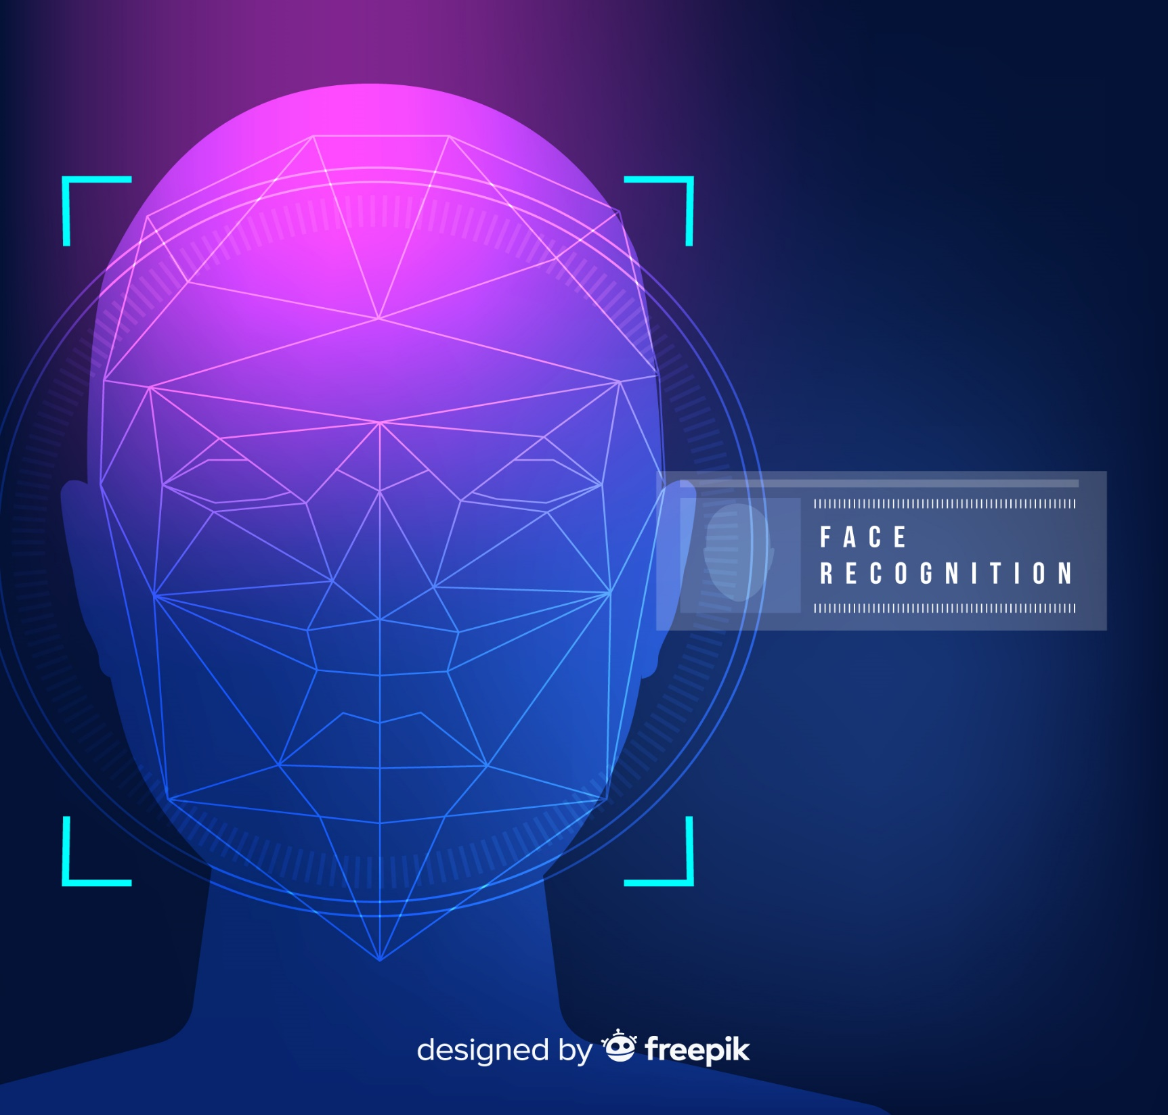
ABHIGNA-160118737002
HARSHITHA-160118737008

Slide 2
CONTENTS
Introduction
Motivation
Problem statement
Work Flow
Methodology
Implementation
Conclusion
Future Scope

Slide 3

1.Introduction
The main objective of this project is to recognize faces from testing dataset images that are randomly selected after the Neural network is trained from training dataset.
The model should be able to recognize the face most accurately even if the image of the person is blurry, or with extra filters or if the image is at different angles. The model is developed using CNN.

Slide 4
2. Motivation
Faculty face major issues such as increase in the student strength in a class, proxy attendance, handling late comers, shortage of time for syllabus coverage.
In an automated system with high accuracy, efforts for taking the attendance will be greatly reduced and there is a possibility of preventing the proxy attendance.
Our attempt is to decrease the effects on the output of the final recognition and to increase the accuracy of the model.

Slide 5
3.Problem statement
To develop a face recognition system to recognize the faces present in the database.

Slide 6
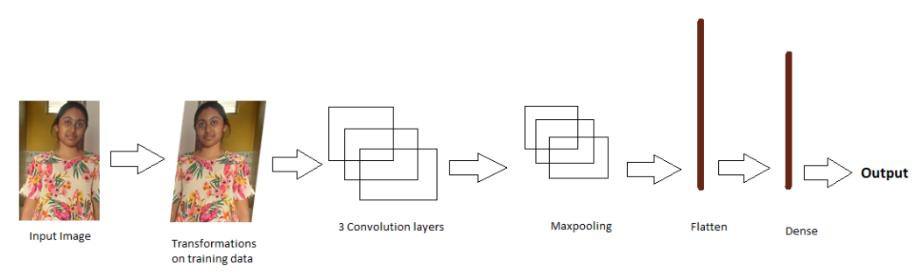
4. Work Flow

Slide 7
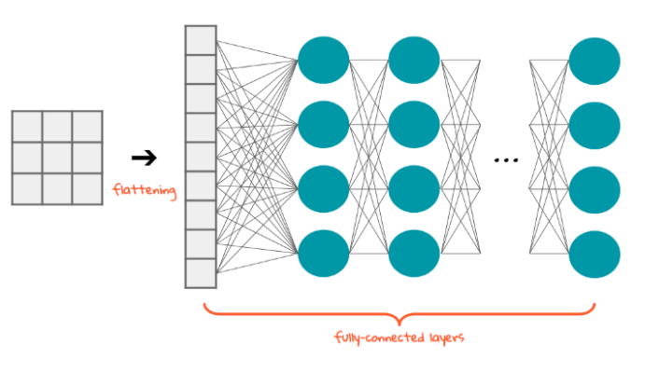

Slide 8
5. Methodology
So, in our proposed methodology, face recognition is achieved using Deep Learning sub-field that is Convolutional Neural Network (CNN).
The system is tested with a dataset generated with 50 images of 10 people each, where we train our model with 45 images using learning algorithms and the model will be able to recognize the other 5 images of each person.

Slide 9
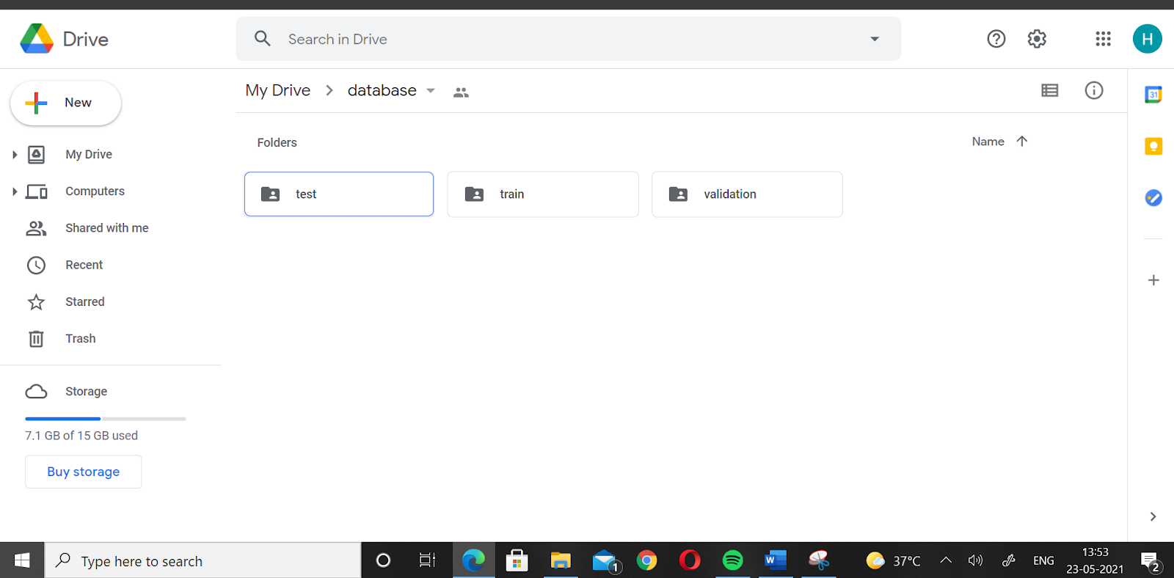
6. Implementation
Dataset:

Slide 10
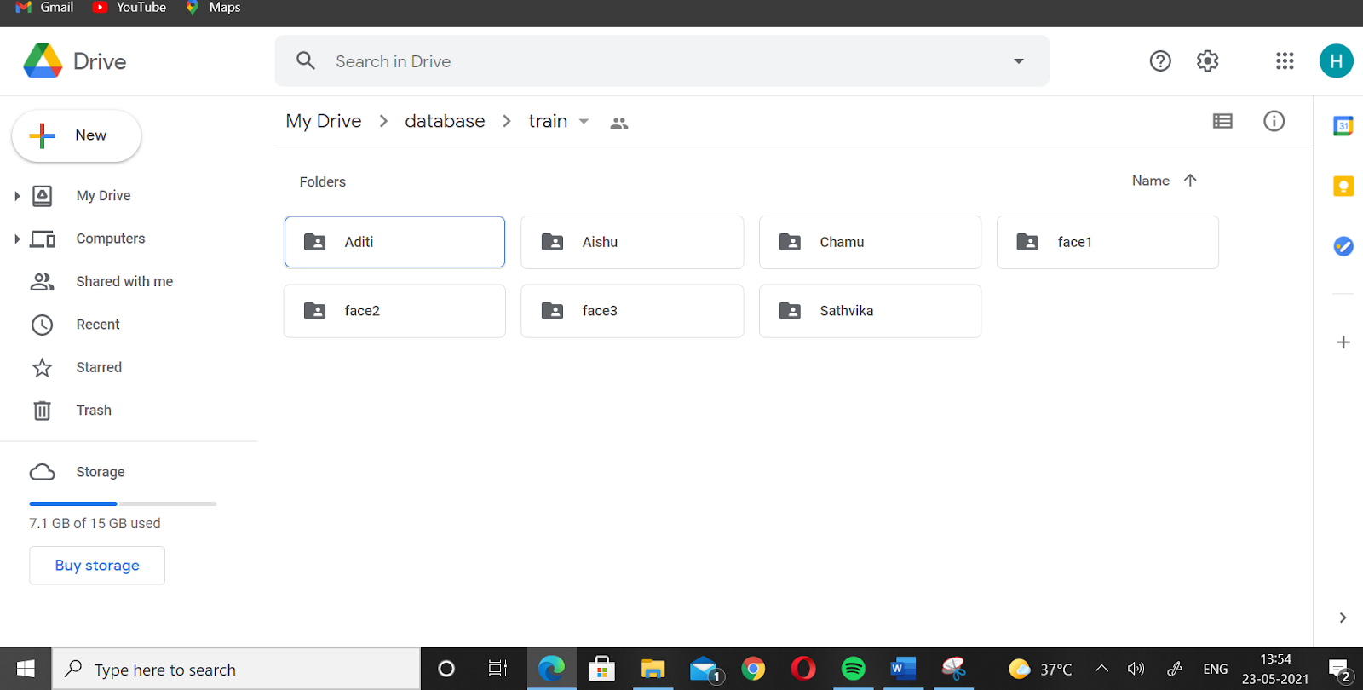

Slide 11
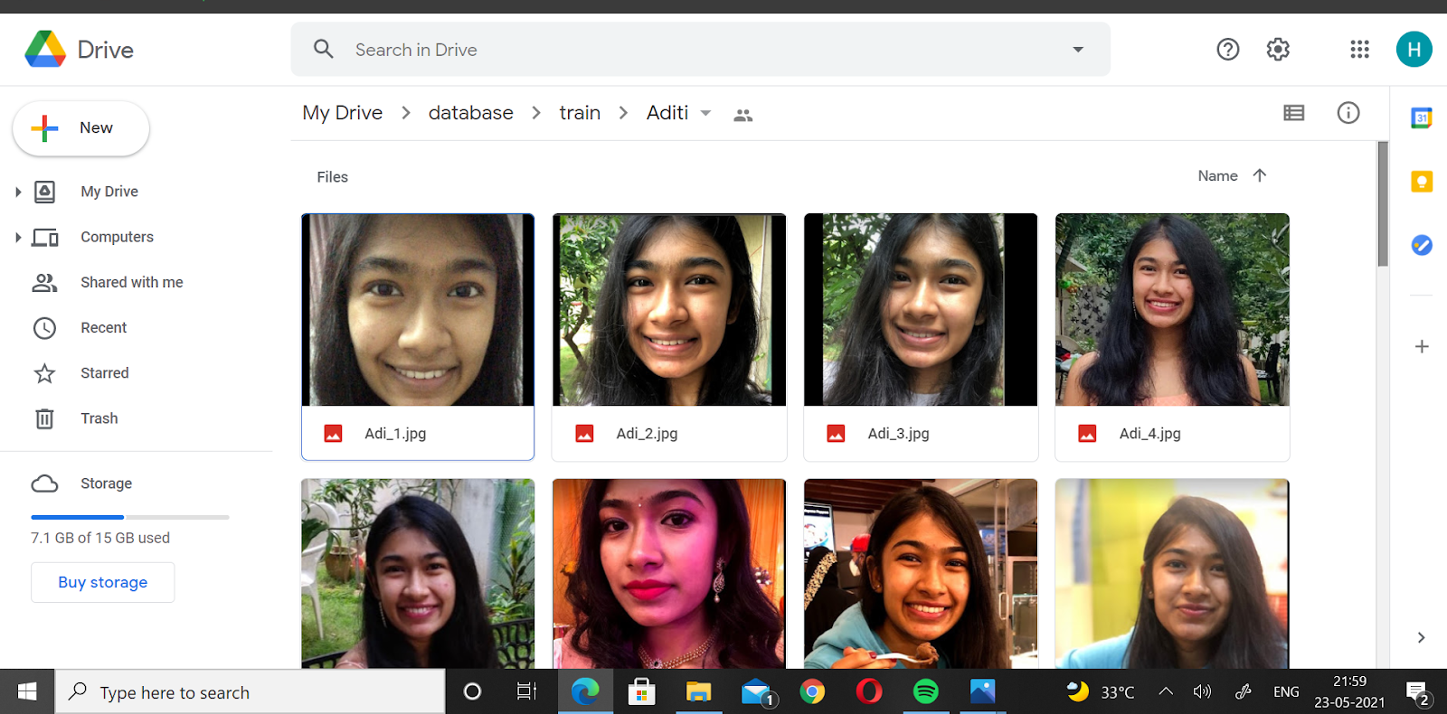

Slide 12
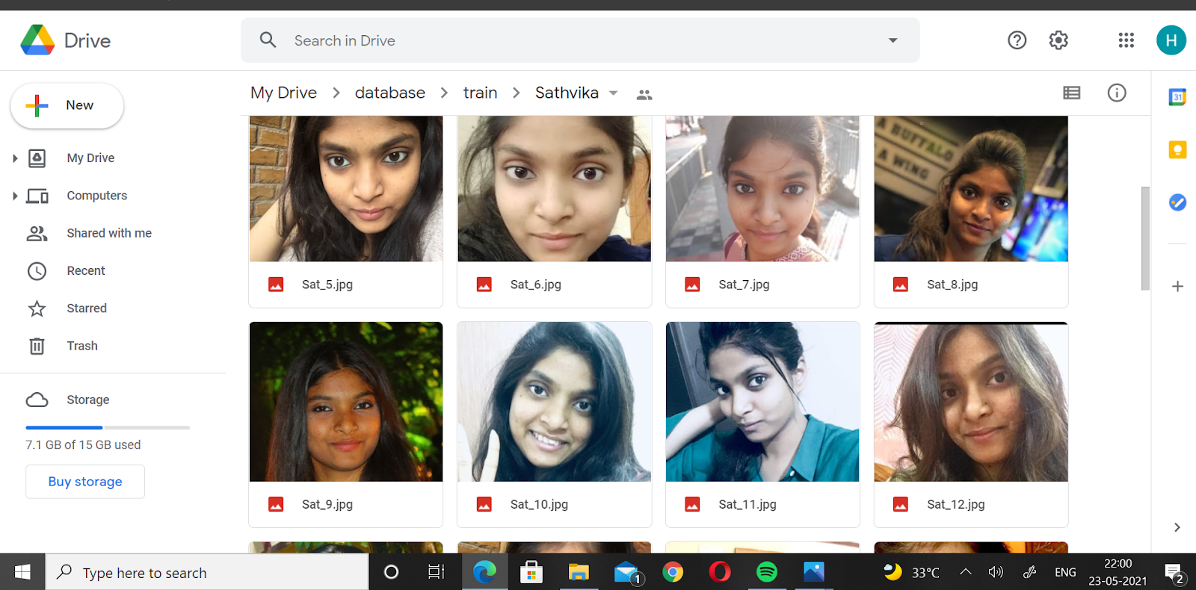

Slide 13
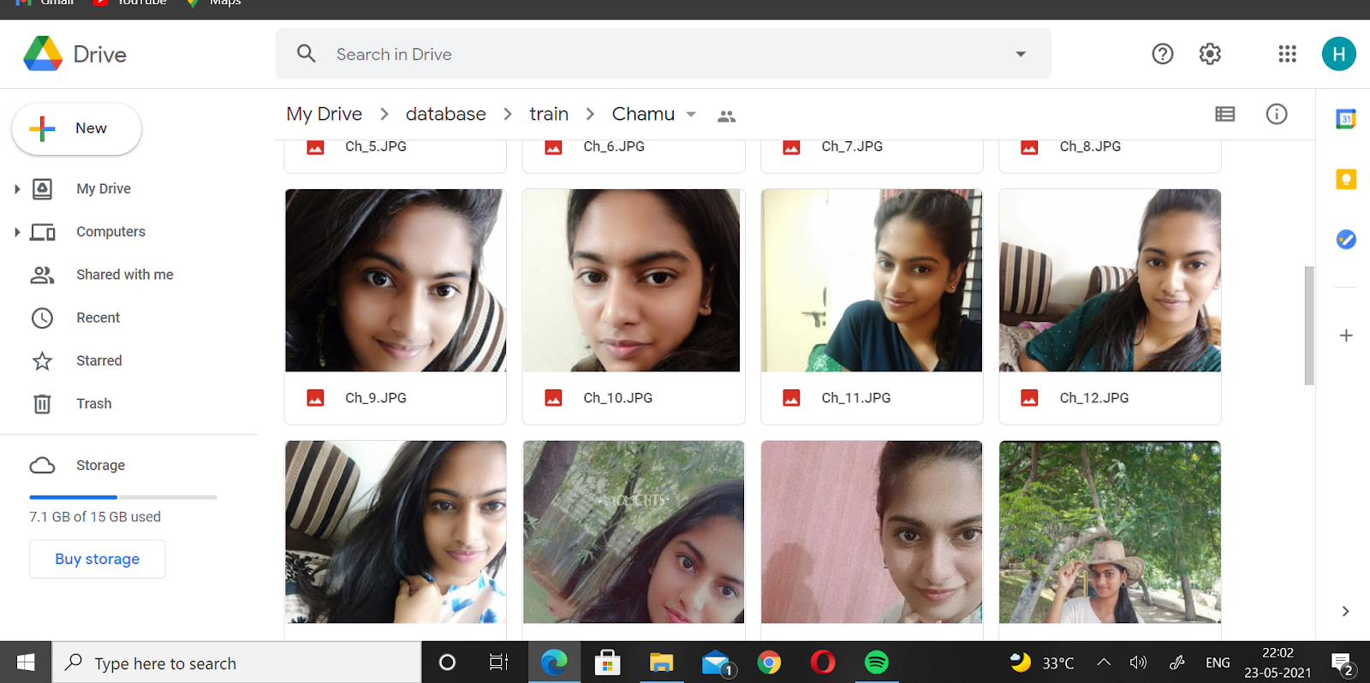

Slide 14
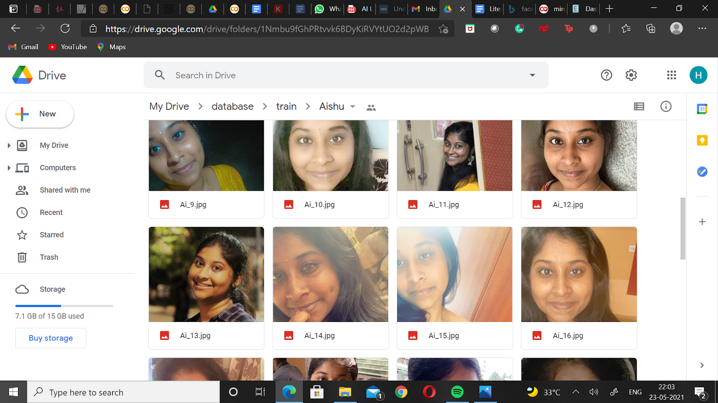

Slide 15
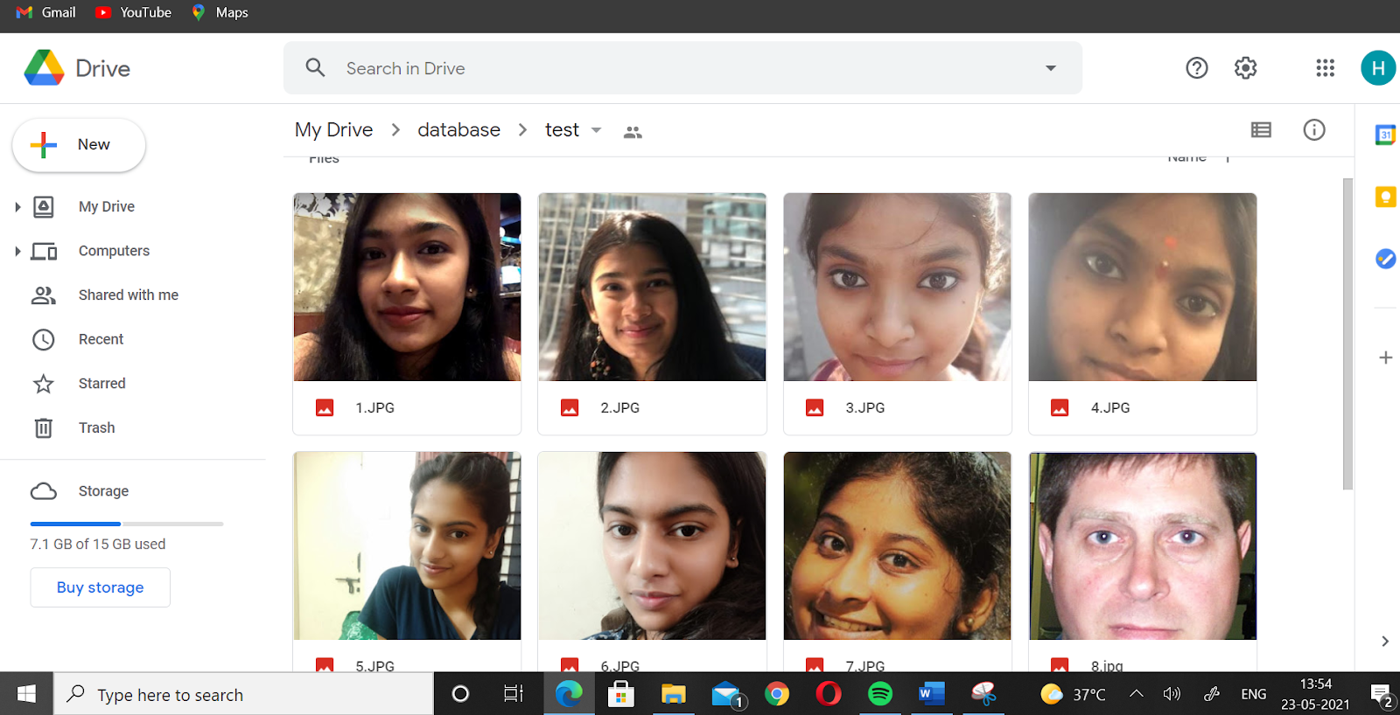

Slide 16
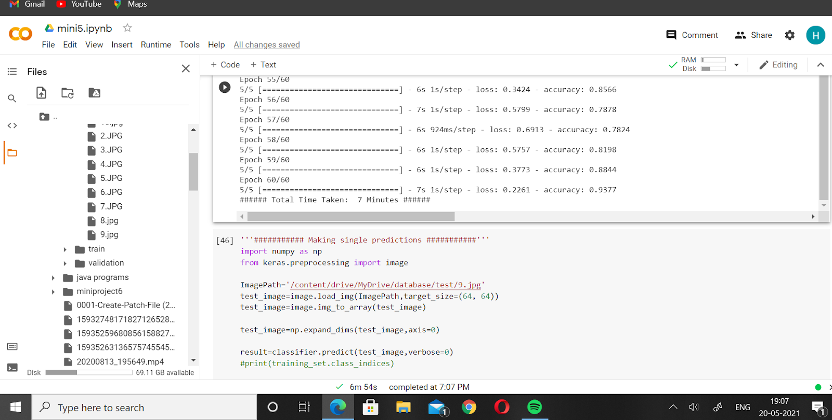
Increase in Accuracy:

Slide 17
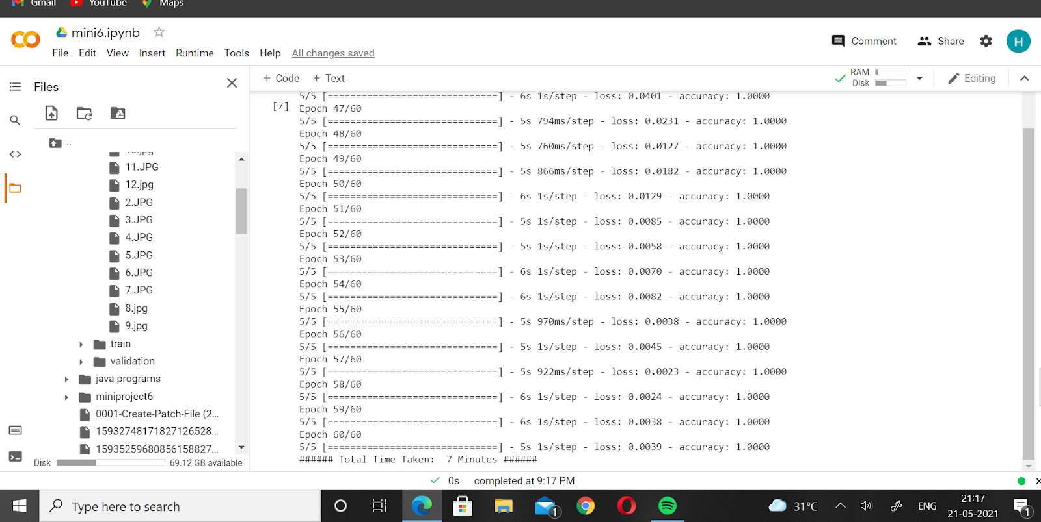

Slide 18
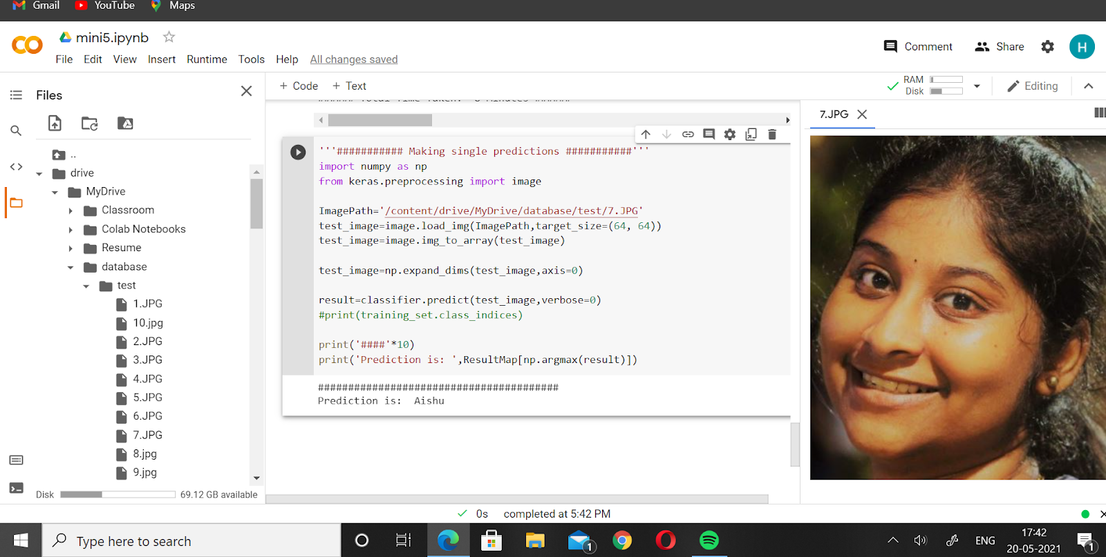
Predictions:

Slide 19
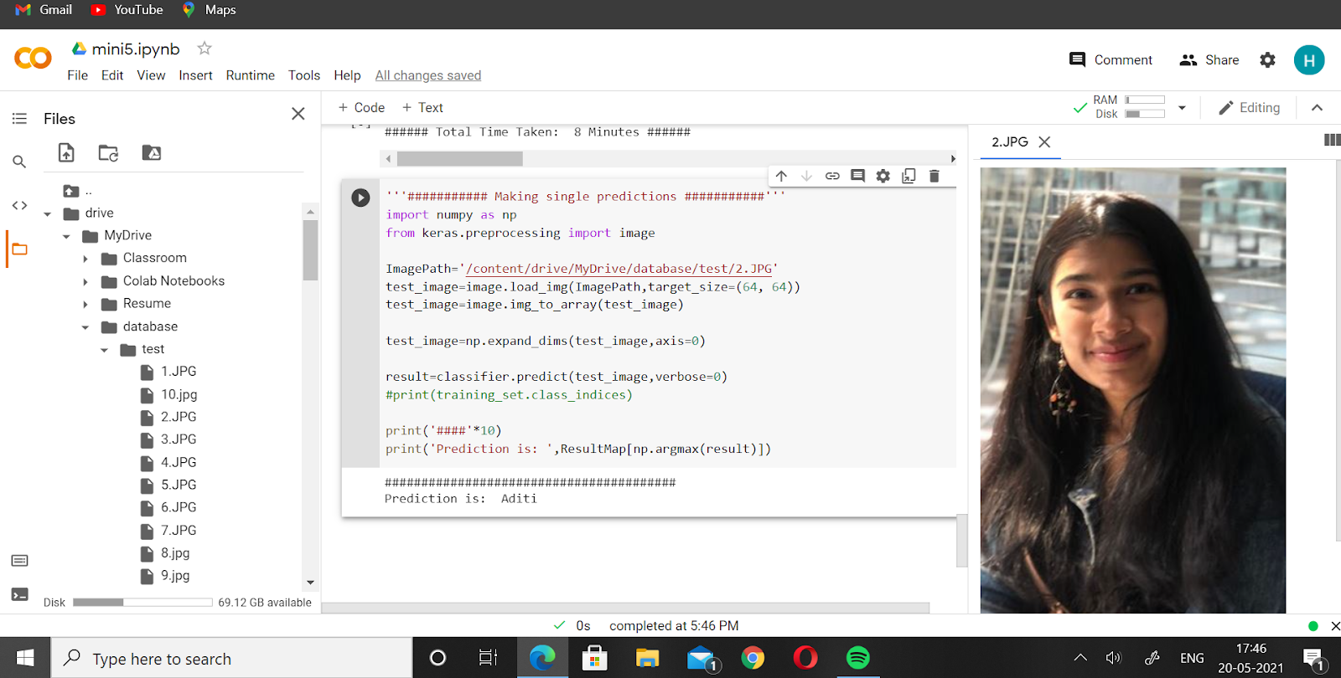

Slide 20
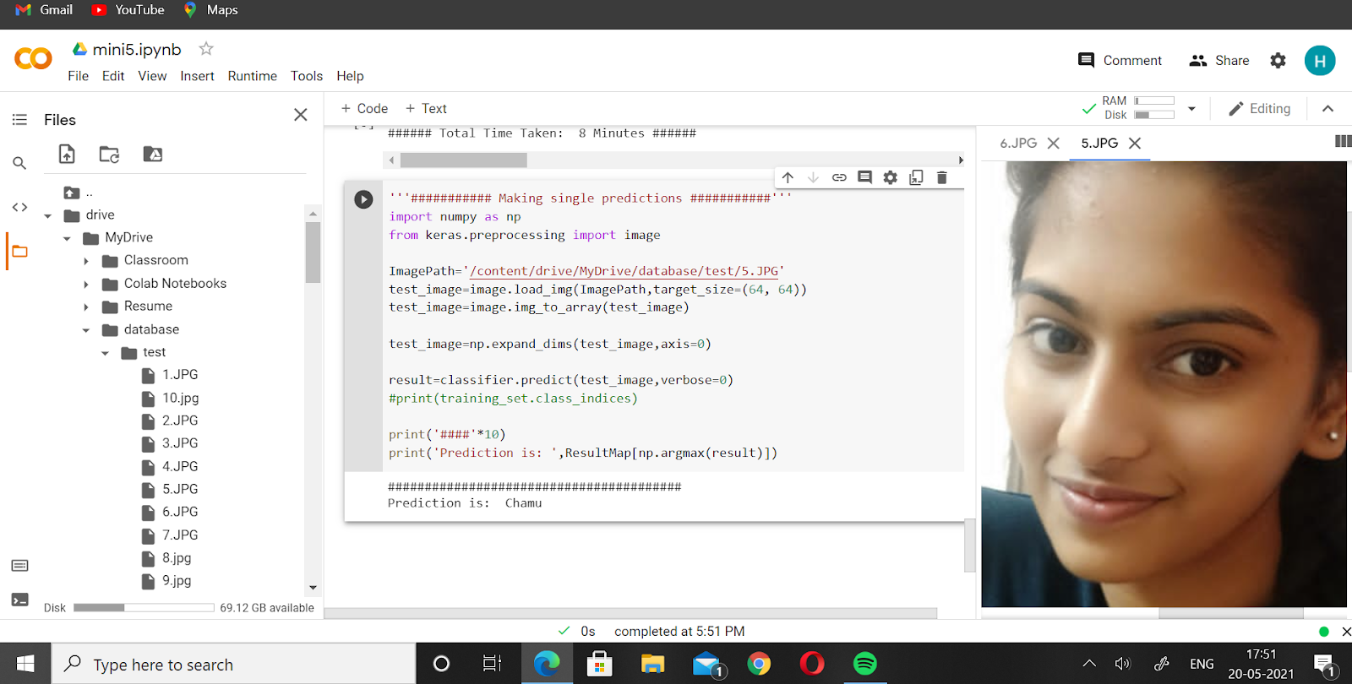

Slide 21
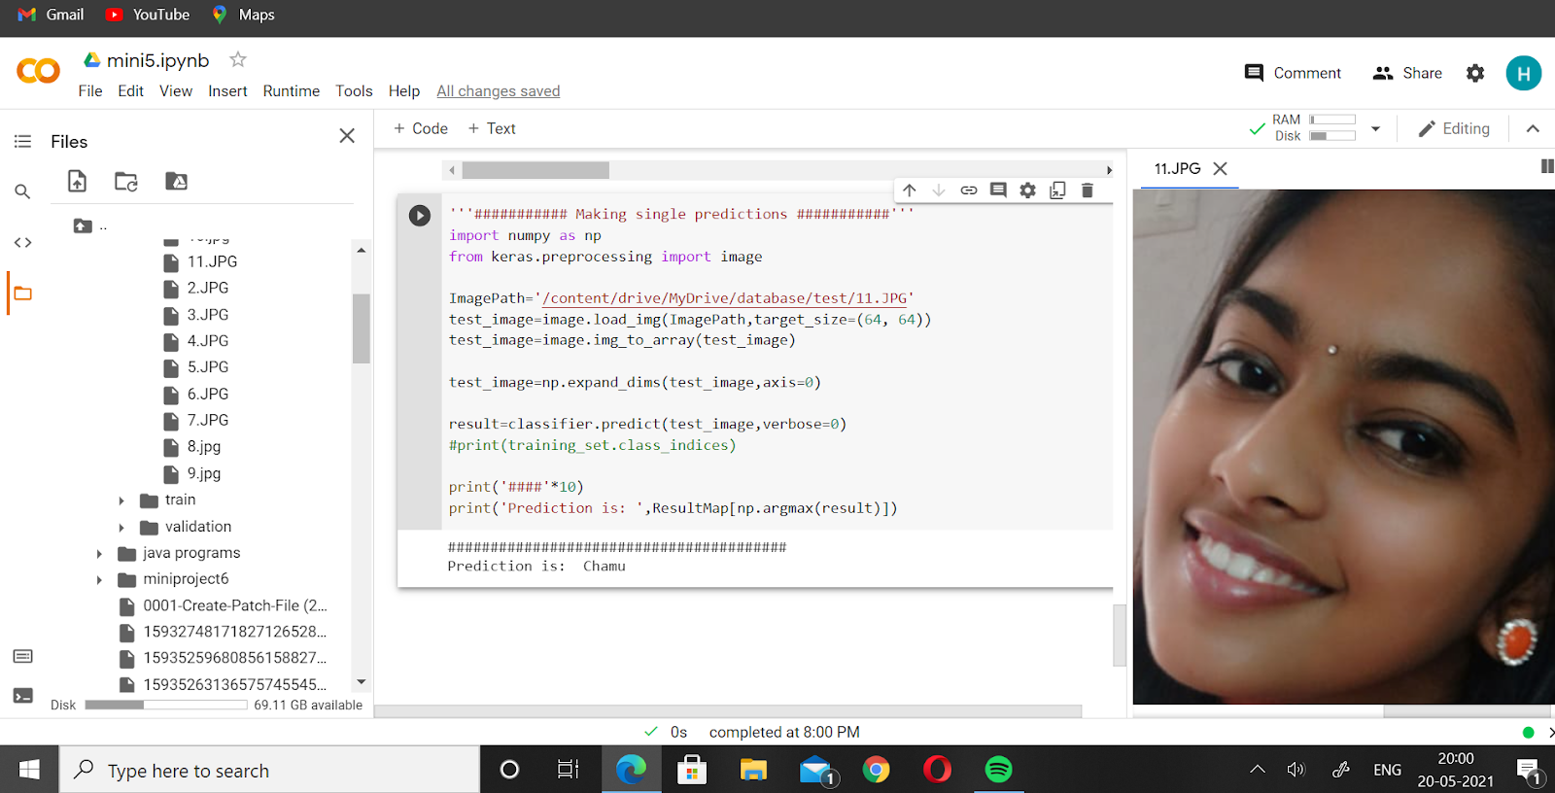

Slide 22
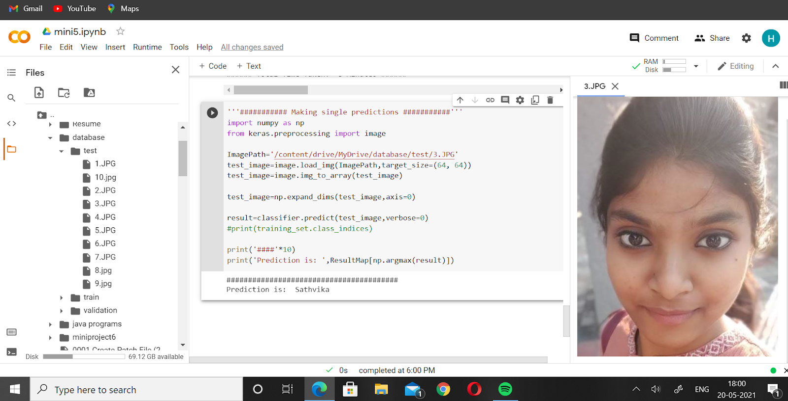

Slide 23
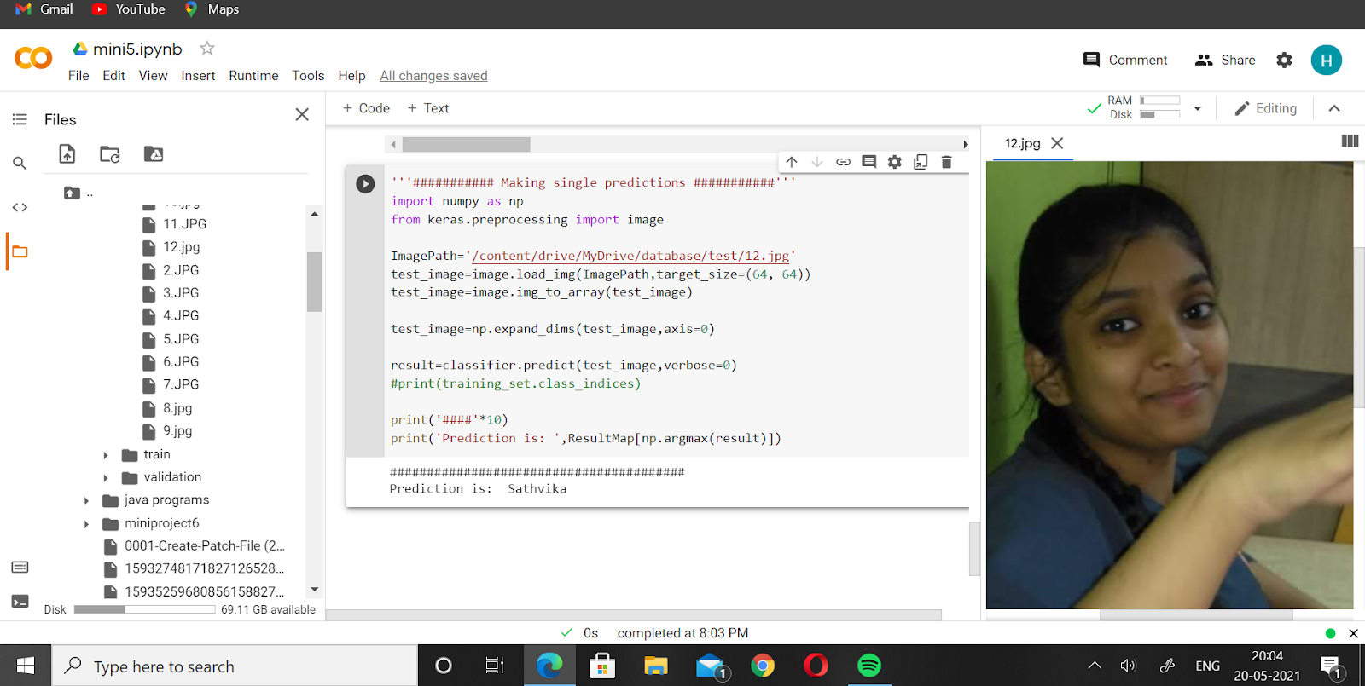

Slide 24
Conclusion
The above system is able to detect the faces correctly of 9 people out of 12 people that are given in the database.

Slide 25
Future Scope
In the future we plan to increase the range of the dataset more and also increase the accuracy of the model even more. We would also improve the model to the point where it would be able to detect even very old pictures of the people. We also want to incorporate this face recognition in automatic attendance. This would be a great way to eliminate manual attendance and would help teachers to have perfect attendance even without taking it manually. This would also help reduce proxy in attendance.

Slide 26
THANK YOU!!

